Slide 1
How To Extract Good Knowledge From Bad Data
An Experiment With 18th-Century French Texts
François Dominic Laramée
PhD candidate in History, Université de Montréal
Presented at CSDH / SCHN 2017 Annual Conference
This work was supported by a FRQSC doctoral scholarship

Slide 2
PRESENTATION STRUCTURE
Four parts
18th-century French print corpora
The sins of Bad Data
How to make Bad Data useful
Some partial results

Slide 3
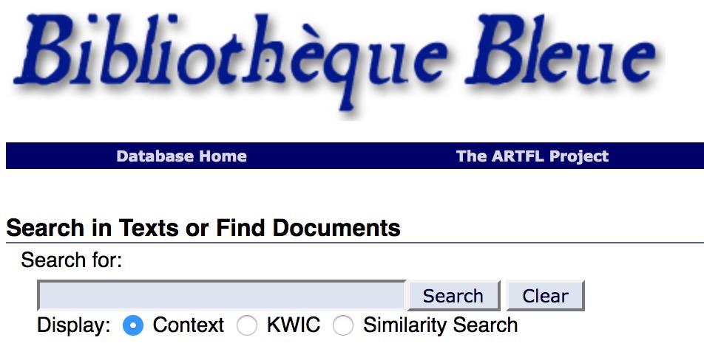
CORPORA TYPES — TRANSCRIBED

Slide 4
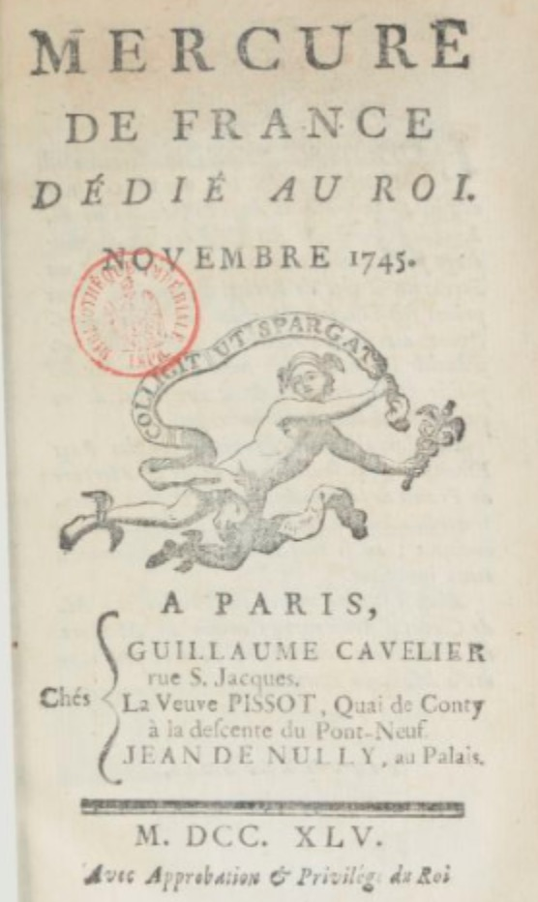
CORPORA TYPES — OCR-GENERATED

Slide 5
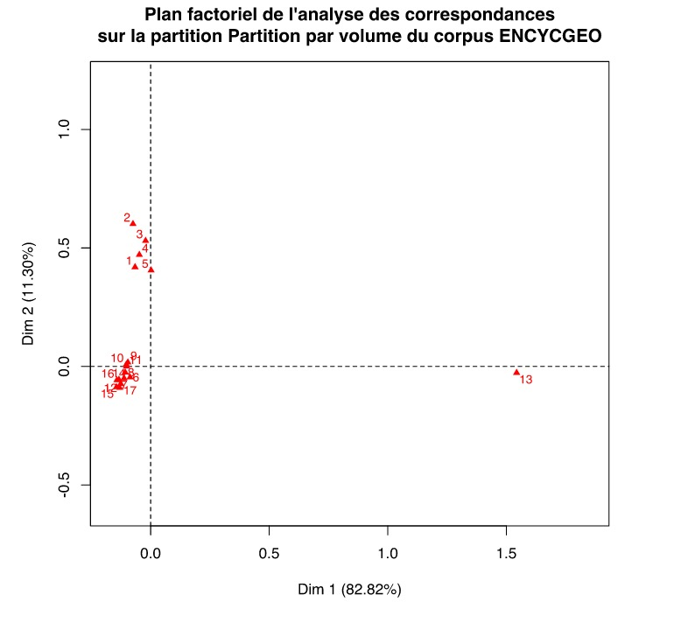
BAD DATA — HIDDEN OUTLIERS

Slide 6
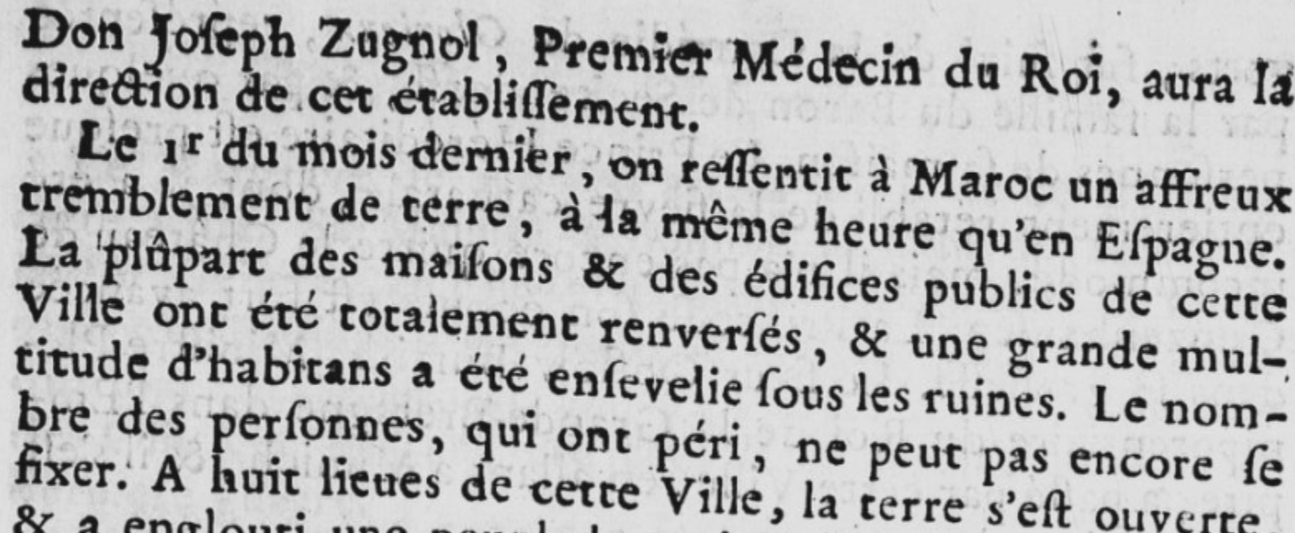
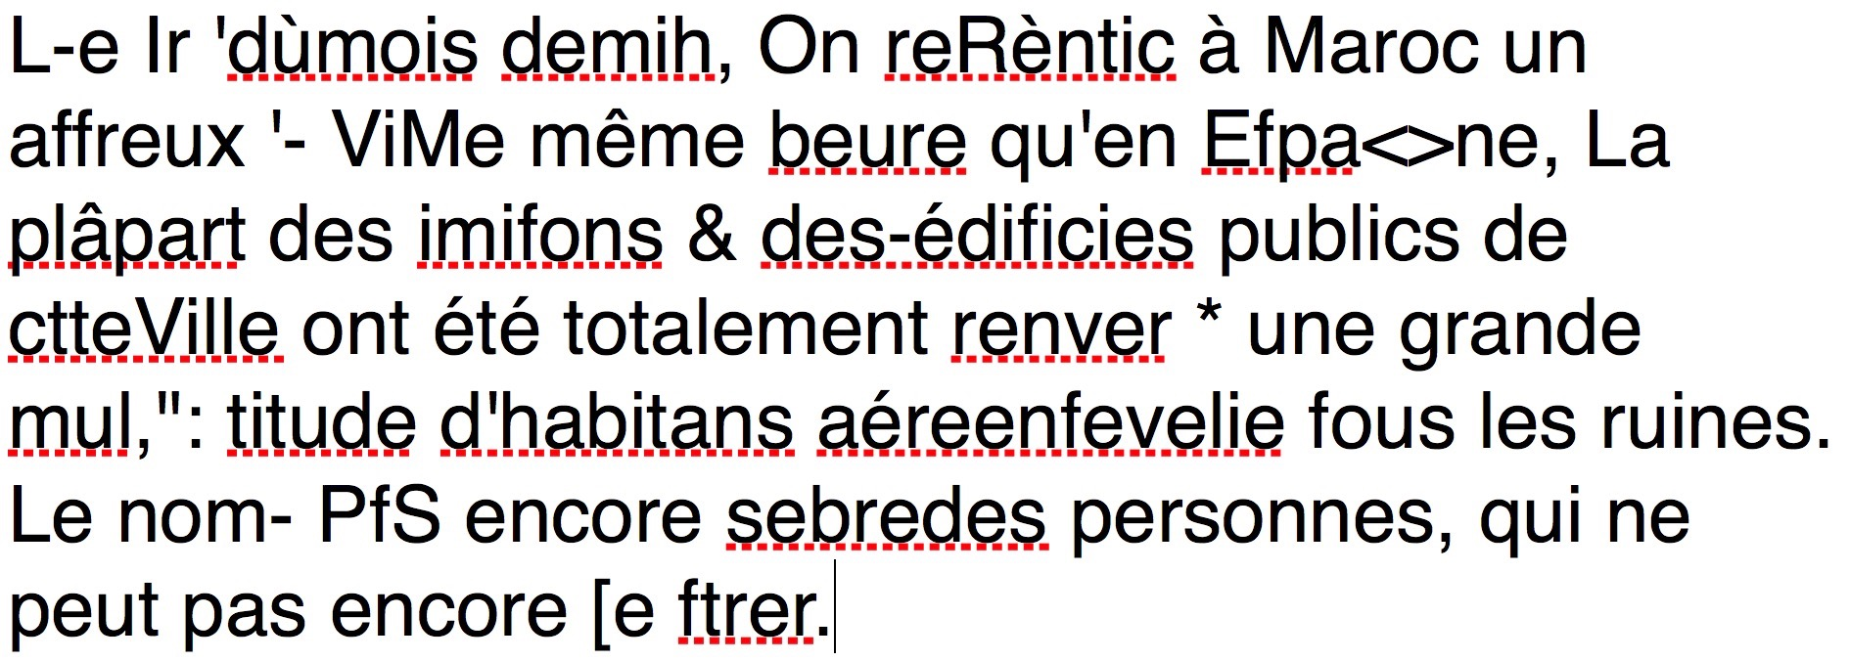
BAD DATA — IRREGULAR SPELLING AND OCR ERRORS

Slide 7
BAD DATA — ARTICLE ENDPOINTS

Slide 8
BAD DATA — ERROR CLUSTERS

Slide 9
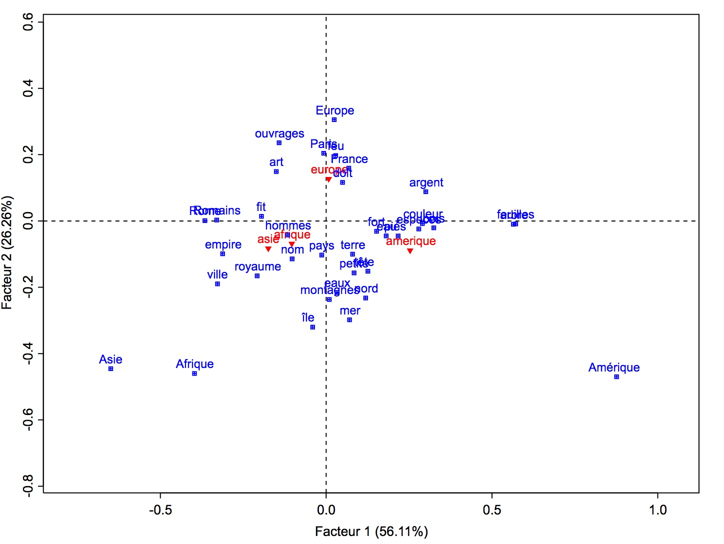
METHOD — HEURISTIC DESIGN

Slide 10
METHOD — HEURISTIC DESIGN
Enhanced focus
Filters out (much of) the noise
Small keyword sets
Manageable projects

Slide 11
LEVENSHTEIN’S ALGORITHM
Keyword | Candidate | Levenshtein Distance | Operations
Amérique | Amérique | 0 | —
Amérique | Amrique | 1 | Delete « é »
Amérique | Cmévrique | 2 | A —> C Insert « v »
Amérique | Musique | 3 | Delete « A » é —> u r —> s

Slide 12
LEVENSHTEIN’S PERFORMANCE
SOME OF THE RECOVERED INSTANCES
Keyword | Keyword occurrences | Alternate forms | Alternate form occurrences | Alternate forms as % of all occs | Examples
Amérique/d’Amérique/l’Amérique | 485 | 36 | 128 | 20,9 % | l’amerique (59), d’amcrique (2), ramërique
Brésil | 5 | 10 | 159 | 97,0 % | bresil (143), bretîl, brcfil
Canada/Canadiens | 139 | 3 | 3 | 2,1 % | canada*, en.canada
Colonie(s) | 411 | 15 | 16 | 3,7 % | 5lonie, coioniej
Domingue/Saint-Domingue | 88 | 11 | 13 | 12,9 % | jjomingue, saintdomingue
TOTAL | 1867 | 103 | 532 | 22,2%% | Increase: 29,5%

Slide 13
COMMON ERROR TYPES
Lopresti (2009)
Phantom blank space, e.g., ‘can ada’
Phantom punctuation, e.g., ‘am.érique’
Underwood
Common splits and merges: m -> in, in -> m, etc.
Ineffective with 18th-century French OCR:
Recovery: 322 tokens, 0.05% accuracy increase

Slide 14
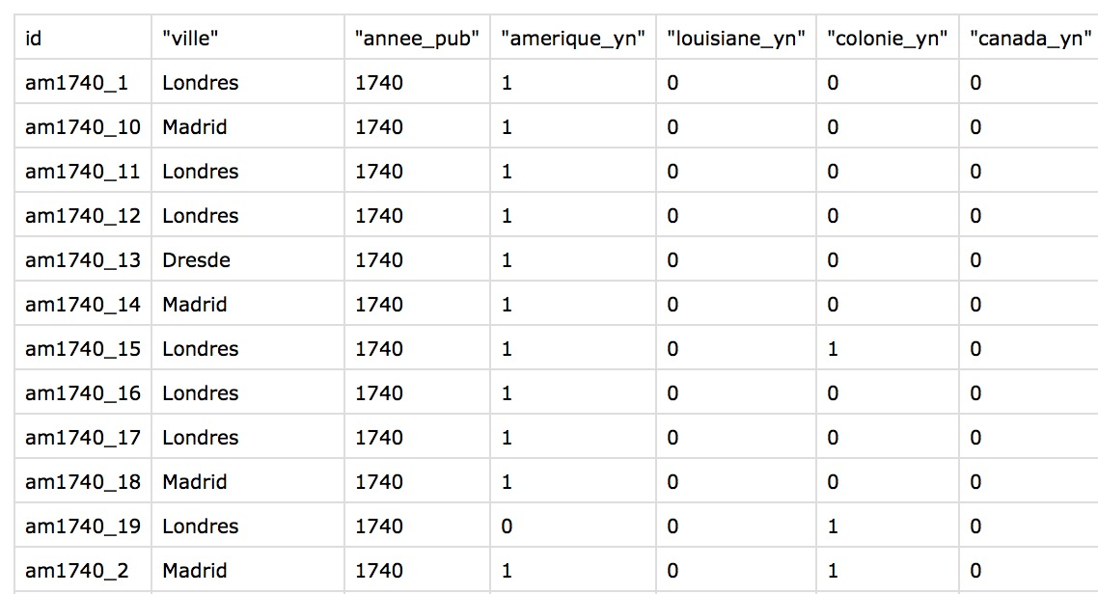
METADATA FILES (EXTRACT)

Slide 15
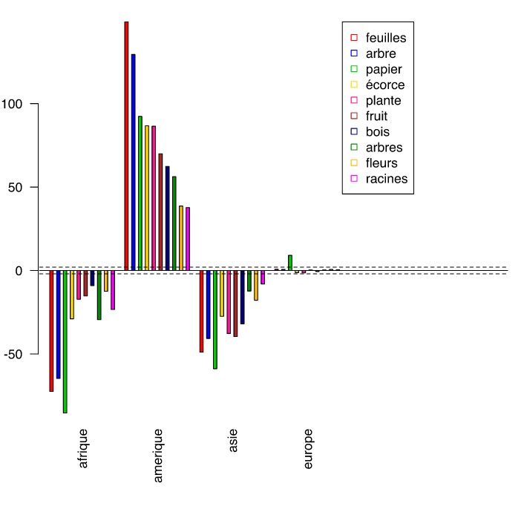
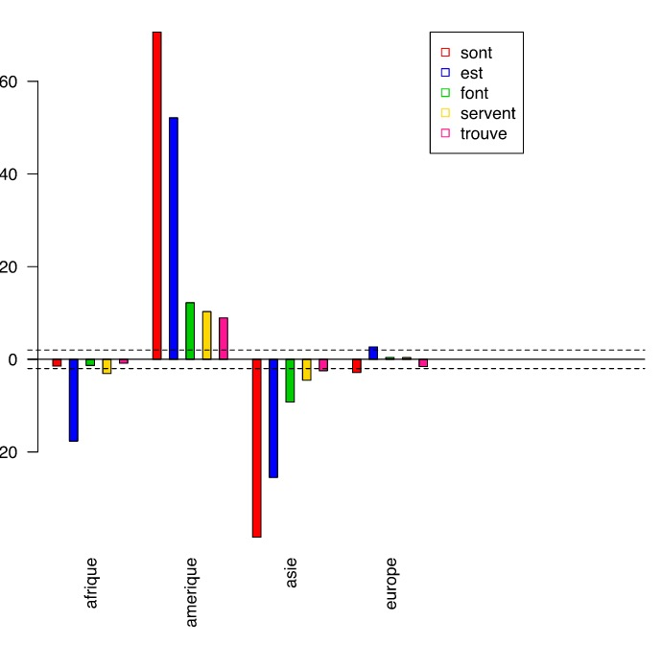
RESULTS — AMERICA IN THE ENCYCLOPÉDIE

Slide 16
RESULTS — BIBLIOTHÈQUE BLEUE
« … thus those who are born in Africa and in America, in places where it is hottest, are in good health, but strangers get sick there. »
— Instruction de la Jeunesse (« Instructing the Young »), 1782.
Source: Bibliothèque Bleue, ARTFL Project

Slide 17
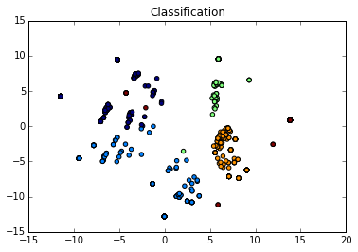
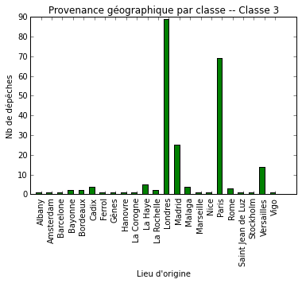
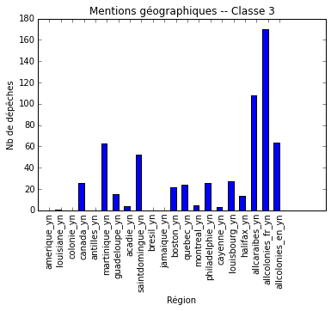
RESULTS — GAZETTE, K-MEANS CLASSIFIER

Slide 18
CONCLUSIONS
Good science from Bad Data?
Sleight of hand > technical wizardry
Construct reliable metadata
Distrust the text
Limit the role of the digital

Slide 19
THANK YOU!
François Dominic Laramée
fdl@francoisdominiclaramee.com
www.francoisdominiclaramee.com
Twitter : @fdlaramee

